Slide 1
Amortized analysis, Fibonacci heaps
CS240 Spring 2023
Rui Fan

Slide 2
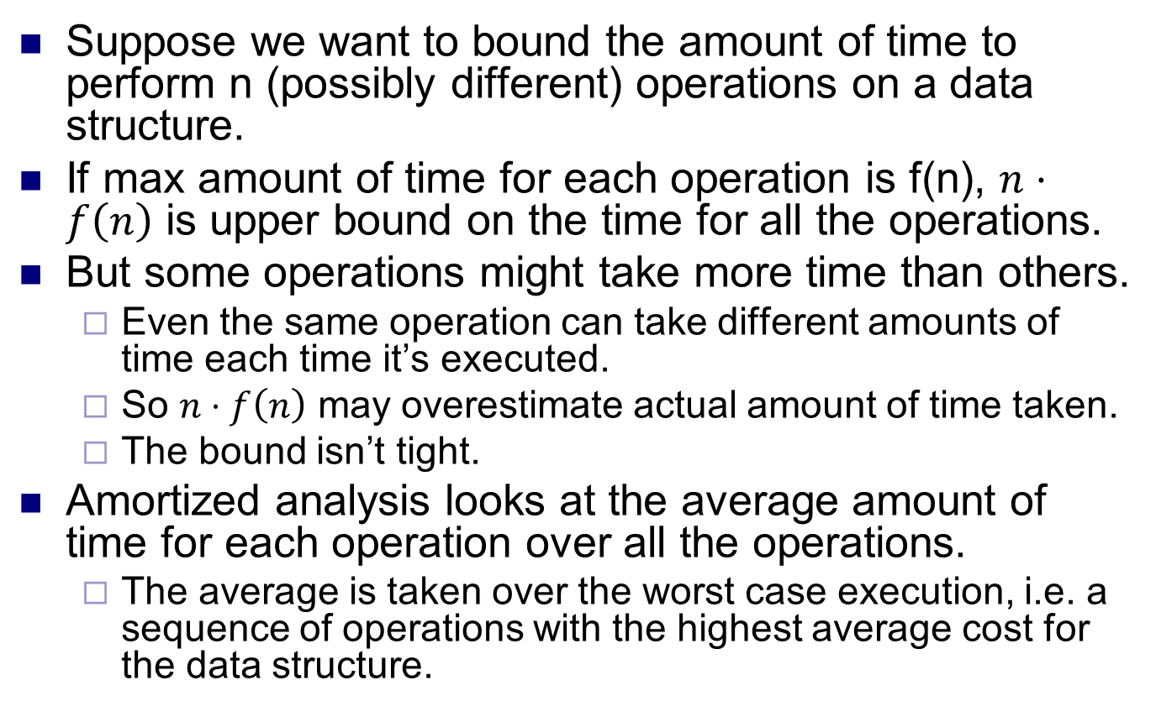
Amortized analysis
Suppose we want to bound the amount of time to perform n (possibly different) operations on a data structure.
If max amount of time for each operation is f(n), $n⋅f\left(n\right)$ is upper bound on the time for all the operations.
But some operations might take more time than others.
Even the same operation can take different amounts of time each time it’s executed.
So $n⋅f\left(n\right)$ may overestimate actual amount of time taken.
The bound isn’t tight.
Amortized analysis looks at the average amount of time for each operation over all the operations.
The average is taken over the worst case execution, i.e. a sequence of operations with the highest average cost for the data structure.

Slide 3
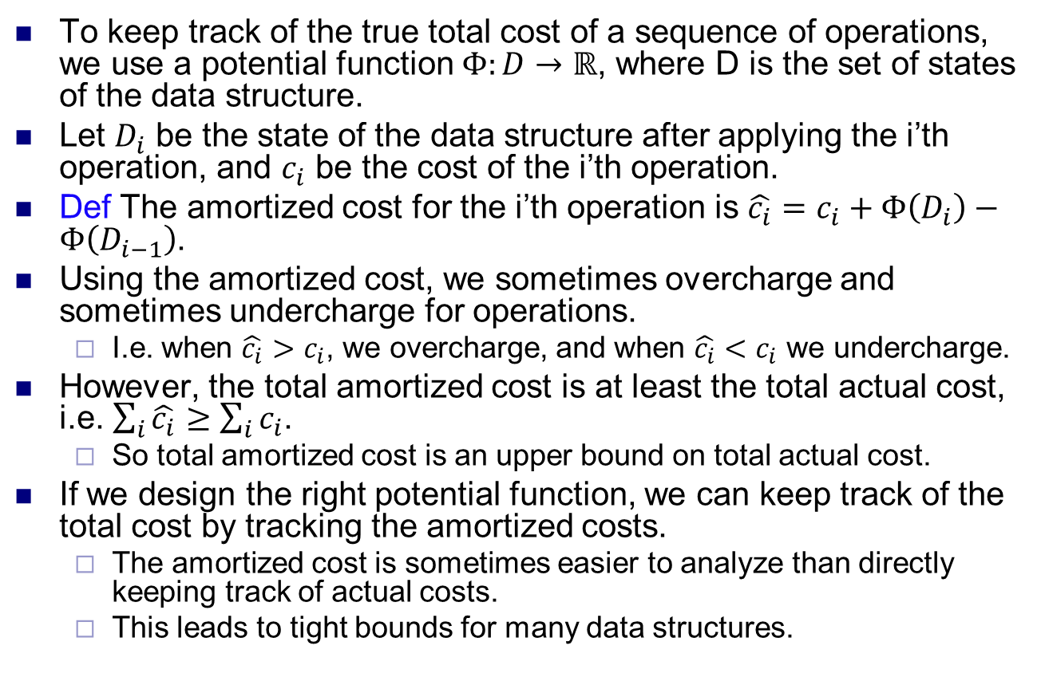
Potential method
To keep track of the true total cost of a sequence of operations, we use a potential function $Φ:D→ℝ$, where D is the set of states of the data structure.
Let $D_{i}$ be the state of the data structure after applying the i’th operation, and $c_{i}$ be the cost of the i’th operation.
Def The amortized cost for the i’th operation is $\hat{c_{i}}=c_{i}+Φ\left(D_{i}\right)−Φ\left(D_{i−1}\right)$.
Using the amortized cost, we sometimes overcharge and sometimes undercharge for operations.
I.e. when $\hat{c_{i}}>c_{i}$, we overcharge, and when $\hat{c_{i}}<c_{i}$ we undercharge.
However, the total amortized cost is at least the total actual cost, i.e. $\sum_{i}{\hat{c_{i}}}≥\sum_{i}{c_{i}}$.
So total amortized cost is an upper bound on total actual cost.
If we design the right potential function, we can keep track of the total cost by tracking the amortized costs.
The amortized cost is sometimes easier to analyze than directly keeping track of actual costs.
This leads to tight bounds for many data structures.

Slide 4
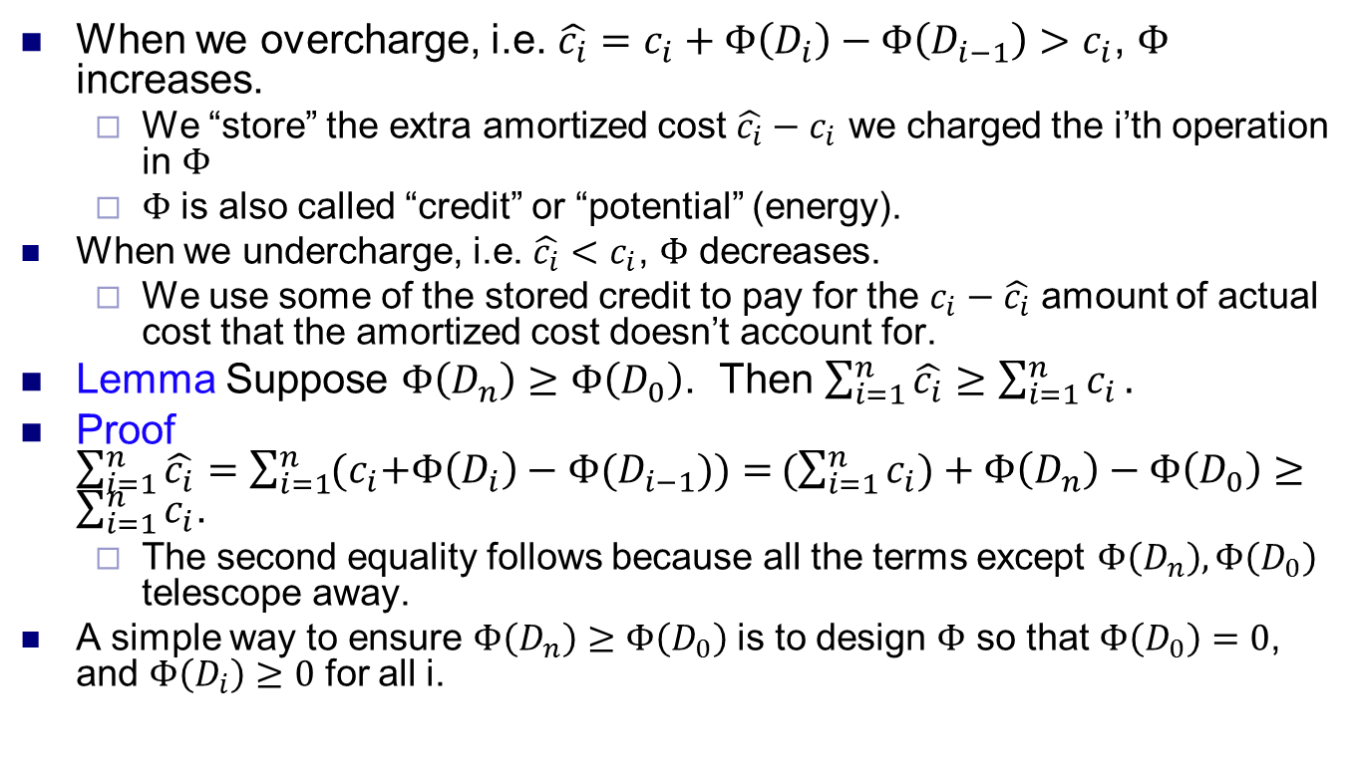
Potential method
When we overcharge, i.e. $\hat{c_{i}}=c_{i}+Φ\left(D_{i}\right)−Φ\left(D_{i−1}\right)>c_{i}$, $Φ$ increases.
We “store” the extra amortized cost $\hat{c_{i}}−c_{i}$ we charged the i’th operation in $Φ$
$Φ$ is also called “credit” or “potential” (energy).
When we undercharge, i.e. $\hat{c_{i}}<c_{i}$, $Φ$ decreases.
We use some of the stored credit to pay for the $c_{i}−\hat{c_{i}}$ amount of actual cost that the amortized cost doesn’t account for.
Lemma Suppose $Φ\left(D_{n}\right)≥Φ\left(D_{0}\right)$. Then $\sum_{i=1}^{n}{\hat{c_{i}}≥\sum_{i=1}^{n}{c_{i}}}.$
Proof$\sum_{i=1}^{n}{\hat{c_{i}}=\sum_{i=1}^{n}{{(c}_{i}+Φ\left(D_{i}\right)−Φ(D_{i−1}}))=}(\sum_{i=1}^{n}{c_{i})+Φ\left(D_{n}\right)−Φ\left(D_{0}\right)}≥\sum_{i=1}^{n}{c_{i}}$.
The second equality follows because all the terms except $Φ\left(D_{n}\right),Φ\left(D_{0}\right)$ telescope away.
A simple way to ensure $Φ\left(D_{n}\right)≥Φ\left(D_{0}\right)$ is to design $Φ$ so that $Φ\left(D_{0}\right)=0$, and $Φ\left(D_{i}\right)≥0$ for all i.

Slide 5
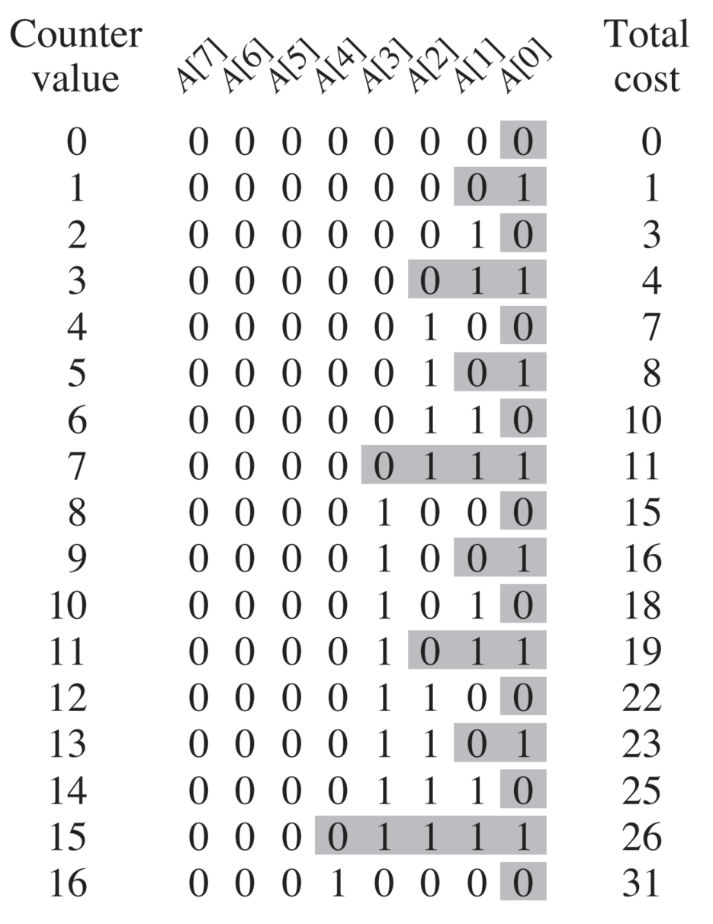
Example: Binary counter
Consider a k-digit binary counter. When we increment the counter, we flip some bits.
Suppose each bit flip costs 1 unit.
What is the total cost for incrementing the counter n times, starting from 0?
Since there are k digits, a trivial upper bound is O(nk).
However, the actual number of bit flips is much less, because most increments only flip a few bits.
We use the potential method to show the total cost is O(n).
In fact, it’s at most 2n.

Slide 6
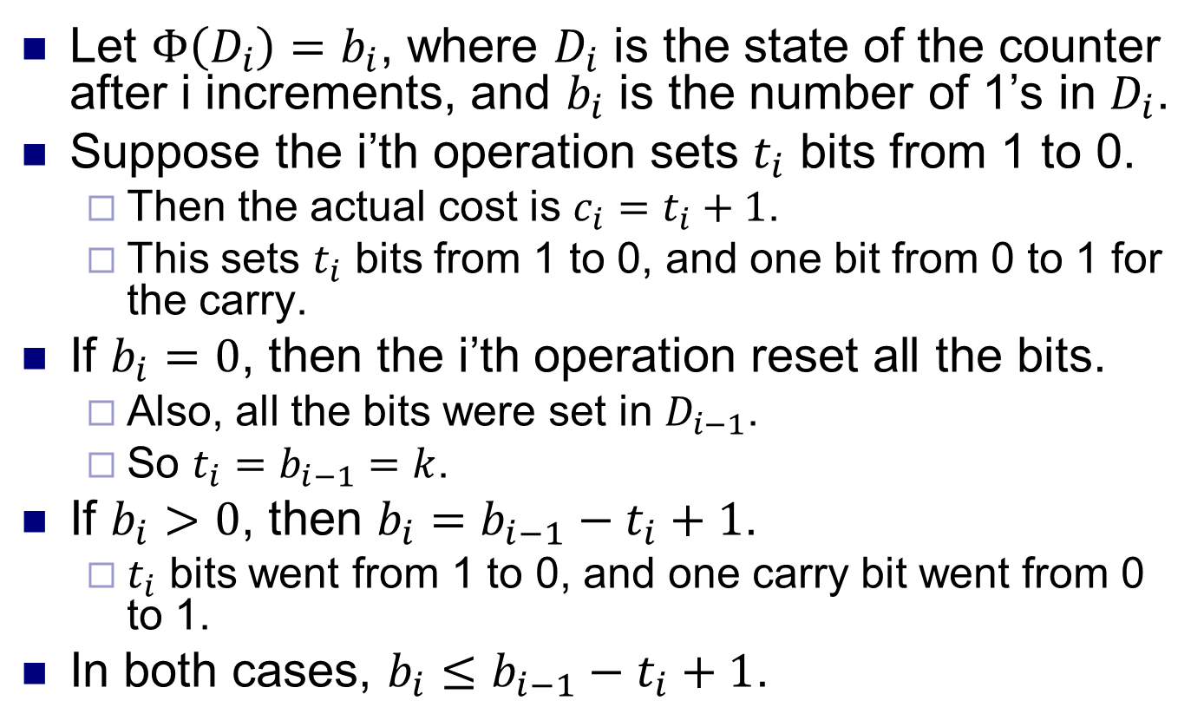
Example: Binary counter
Let $Φ\left(D_{i}\right)=b_{i}$, where $D_{i}$ is the state of the counter after i increments, and $b_{i}$ is the number of 1’s in $D_{i}$.
Suppose the i’th operation sets $t_{i}$ bits from 1 to 0.
Then the actual cost is $c_{i}=t_{i}+1$.
This sets $t_{i}$ bits from 1 to 0, and one bit from 0 to 1 for the carry.
If $b_{i}=0$, then the i’th operation reset all the bits.
Also, all the bits were set in $D_{i−1}$.
So $t_{i}=b_{i−1}=k$.
If $b_{i}>0$, then $b_{i}=b_{i−1}−t_{i}+1$.
$t_{i}$ bits went from 1 to 0, and one carry bit went from 0 to 1.
In both cases, $b_{i}≤b_{i−1}−t_{i}+1$.

Slide 7
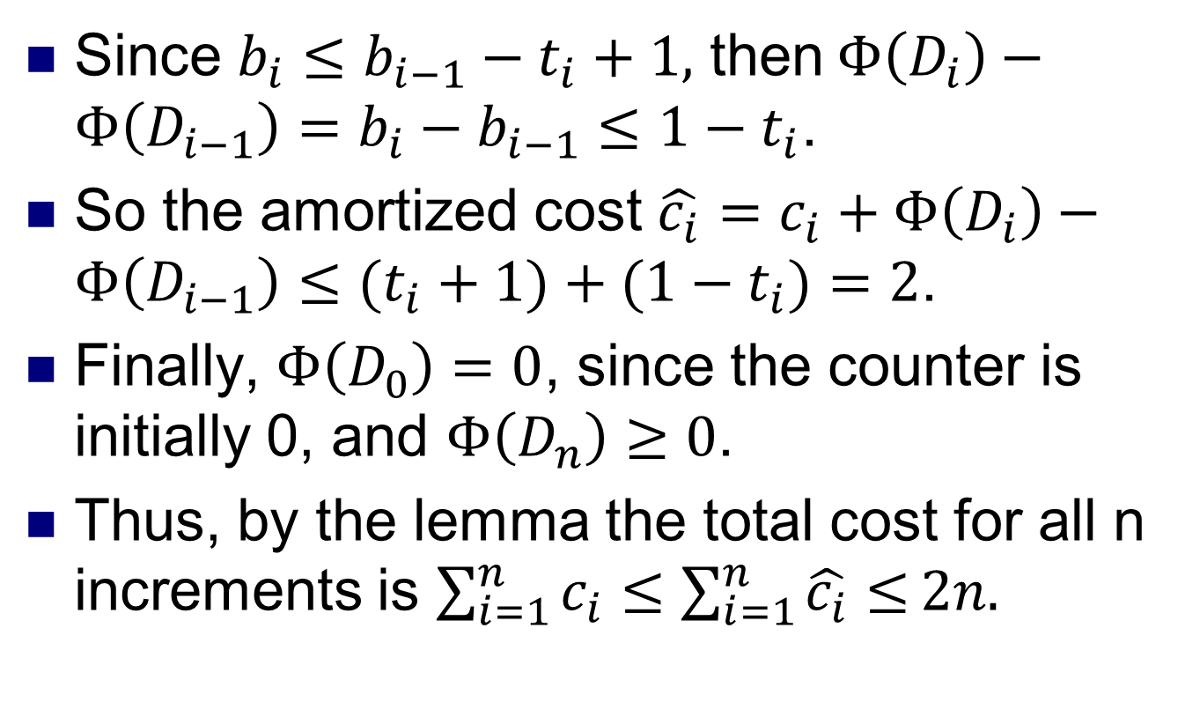
Example: Binary counter
Since $b_{i}≤b_{i−1}−t_{i}+1,$ then $Φ\left(D_{i}\right)−Φ\left(D_{i−1}\right)=b_{i}−b_{i−1}≤1−t_{i}$.
So the amortized cost $\hat{c_{i}}=c_{i}+Φ\left(D_{i}\right)−Φ\left(D_{i−1}\right)≤(t_{i}+1)+(1−t_{i})=2$.
Finally, $Φ\left(D_{0}\right)=0$, since the counter is initially 0, and $Φ\left(D_{n}\right)≥0$.
Thus, by the lemma the total cost for all n increments is $\sum_{i=1}^{n}{c_{i}}≤\sum_{i=1}^{n}{\hat{c_{i}}≤}2n.$

Slide 8
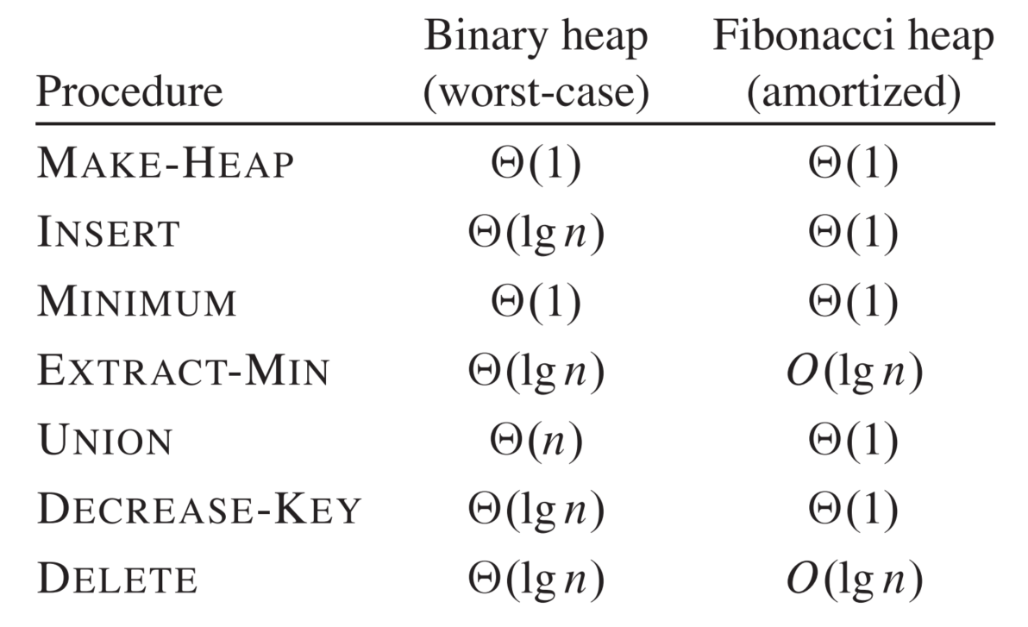
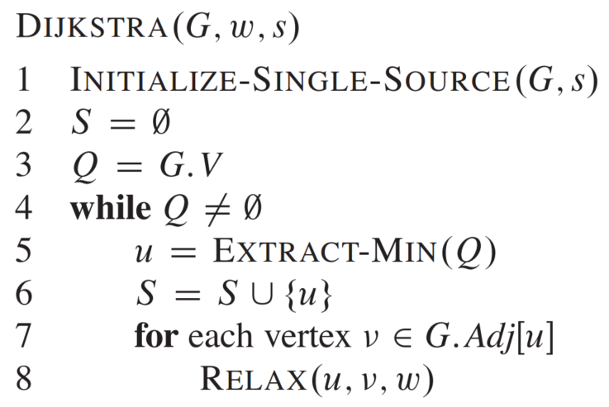
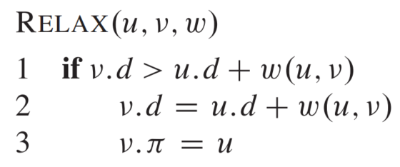
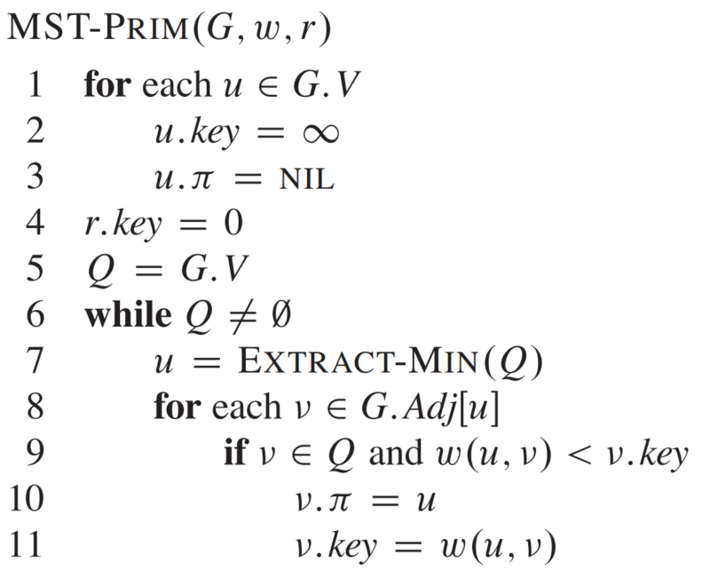
Fibonacci heaps
A Fibonacci heap is a type of heap that implements certain operations faster than a binary heap, in amortized time.
The time complexities of the circled operations are amortized. The rest are worst case.
It can be used to speed up a number of graph algorithms asymptotically.
Both Dijkstra’s and Prim’s algorithms take O((V+E) log V) time with a binary heap, and O(E + V log V) time with a Fibonacci heap.
Both algorithms decrease the key value heap items O(E) times.
This takes O(E log V) time on a binary heap, and O(E) time on a Fibonacci heap.
Fibonacci heaps are more complicated than binary heaps, and often don’t perform better in practice.
When decreasing or deleting a key, assume we have a pointer to the node with the key.
Otherwise finding the node takes O(n) time, where n is the number of items.

Slide 9
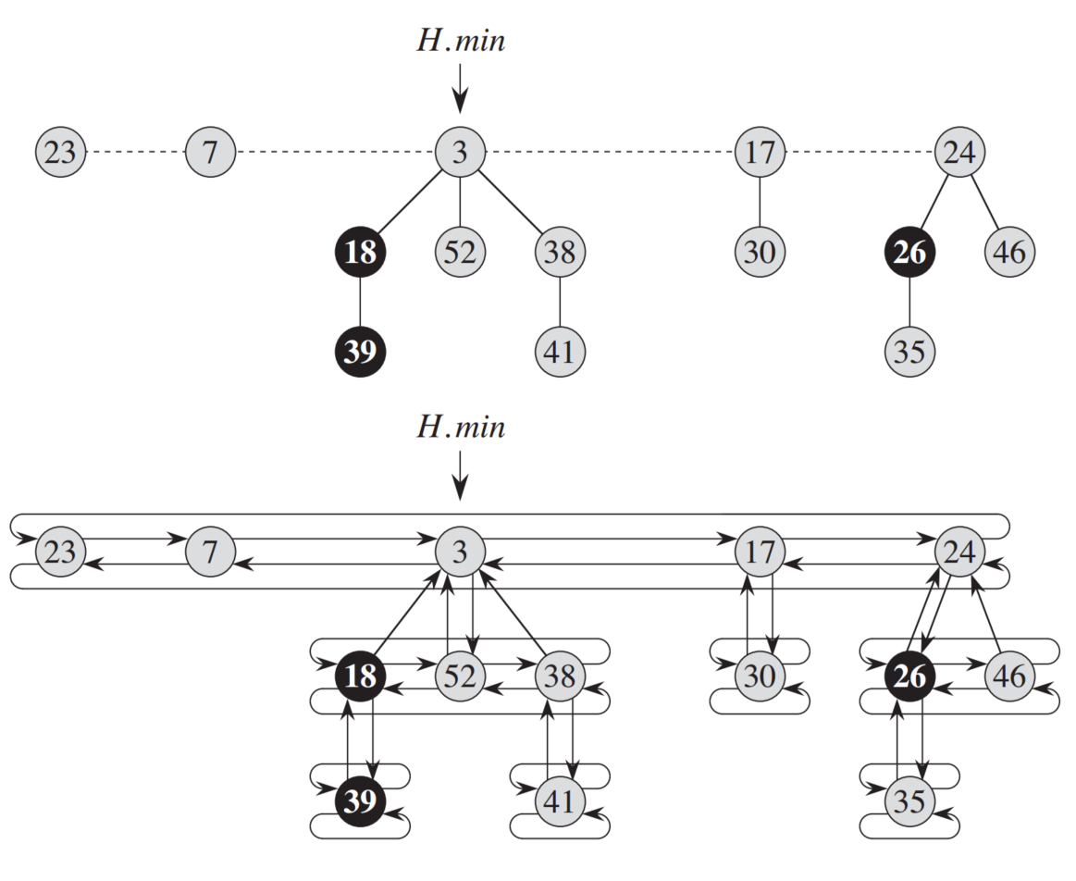
Structure of Fibonacci heap
A Fibonacci heap H consists of a set of rooted trees.
Each tree satisfies the min heap property, i.e. each node’s key is less than those of all its children.
The trees are linked in a doubly-linked root list.
These roots are connected by the dashed line in the top figure.
The minimum node is a root, and is pointed to by H.min.
H.n stores the total number of nodes in all trees.
Within each tree, the nodes at each level are also linked in a doubly-linked list.
The two figures show the same Fibonacci heap, but the top figure avoids showing the linked list for clarity.

Slide 10
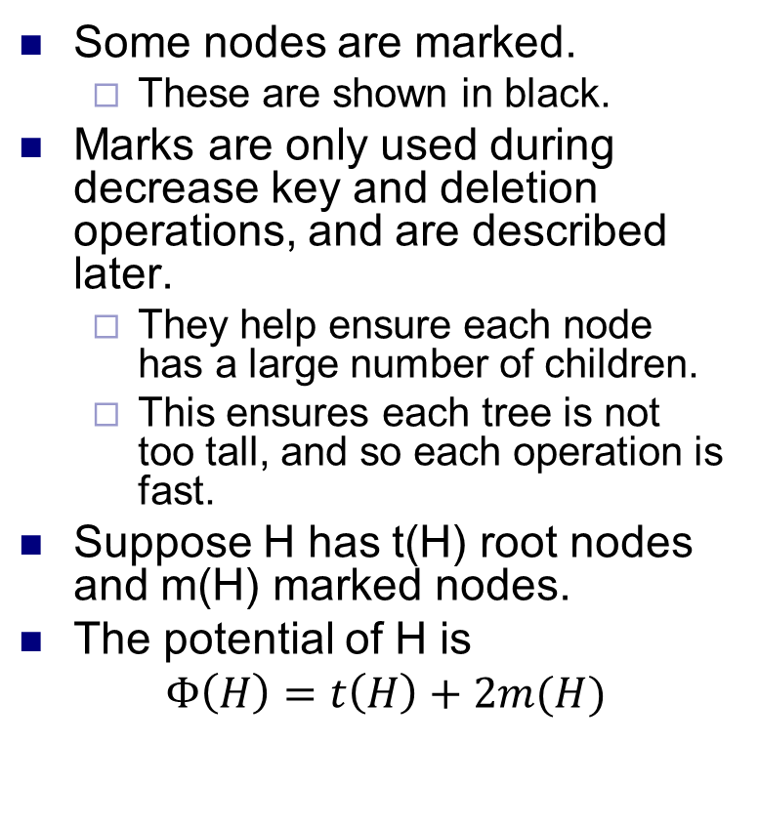
Potential function
Some nodes are marked.
These are shown in black.
Marks are only used during decrease key and deletion operations, and are described later.
They help ensure each node has a large number of children.
This ensures each tree is not too tall, and so each operation is fast.
Suppose H has t(H) root nodes and m(H) marked nodes.
The potential of H is
$Φ\left(H\right)=t\left(H\right)+2m(H)$

Slide 11
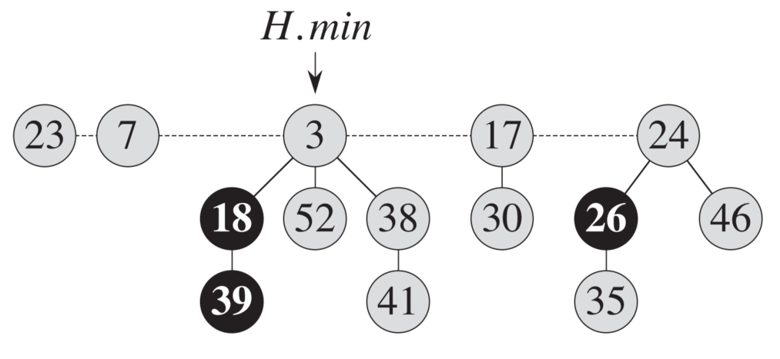
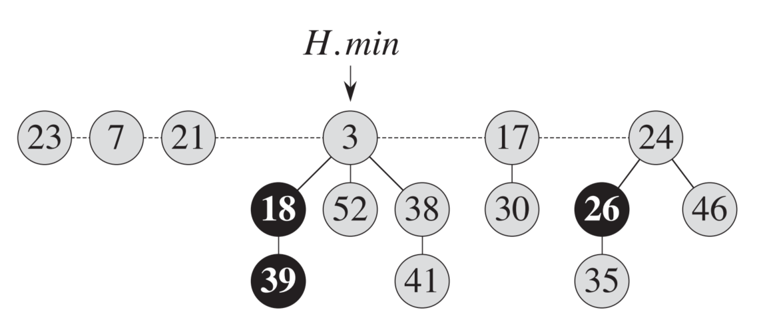
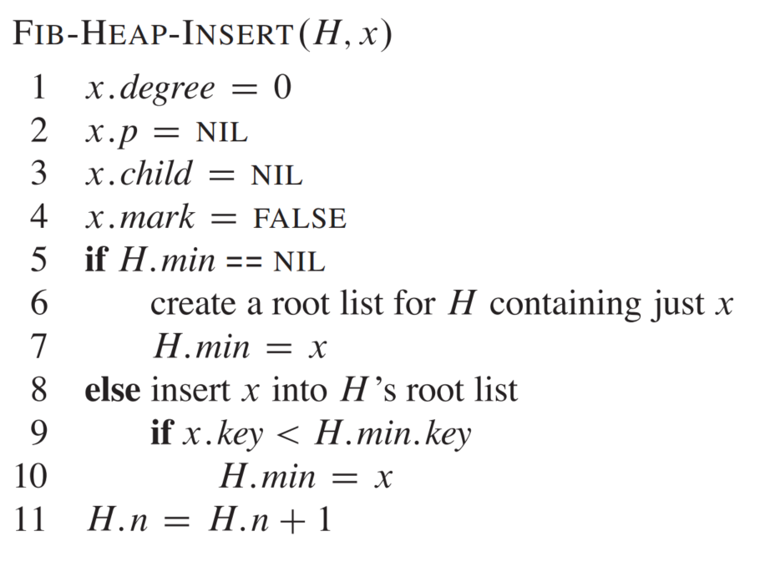
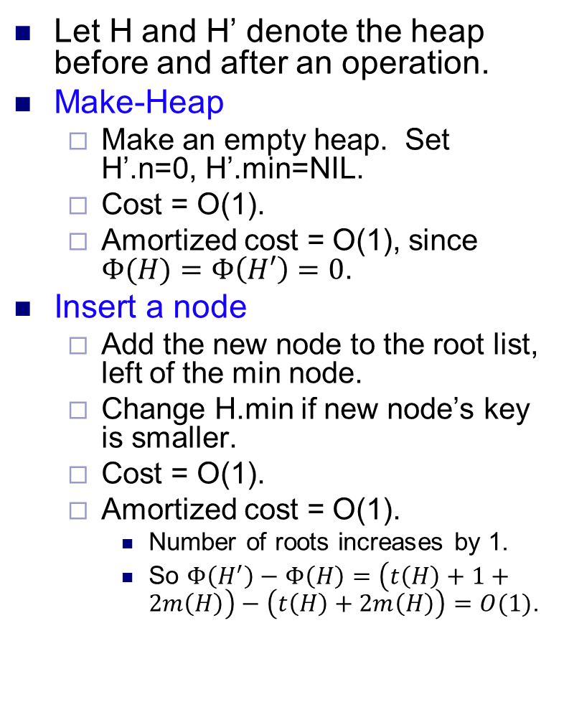
Basic operations
Let H and H’ denote the heap before and after an operation.
Make-Heap
Make an empty heap. Set H’.n=0, H’.min=NIL.
Cost = O(1).
Amortized cost = O(1), since $Φ(H)=Φ\left(H′\right)=0$.
Insert a node
Add the new node to the root list, left of the min node.
Change H.min if new node’s key is smaller.
Cost = O(1).
Amortized cost = O(1).
Number of roots increases by 1.
So $Φ\left(H^{′}\right)−Φ\left(H\right)=\left(t\left(H\right)+1+2m\left(H\right)\right)−\left(t\left(H\right)+2m\left(H\right)\right)=O(1)$.

Slide 12
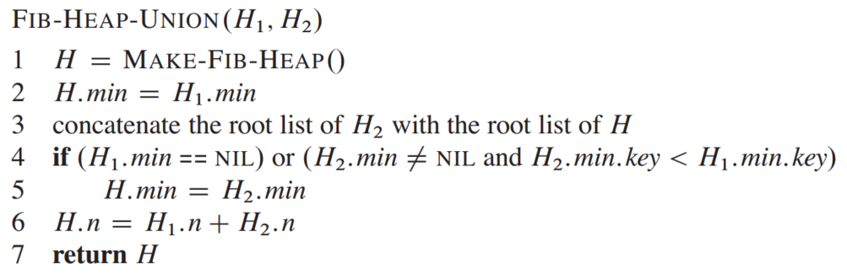
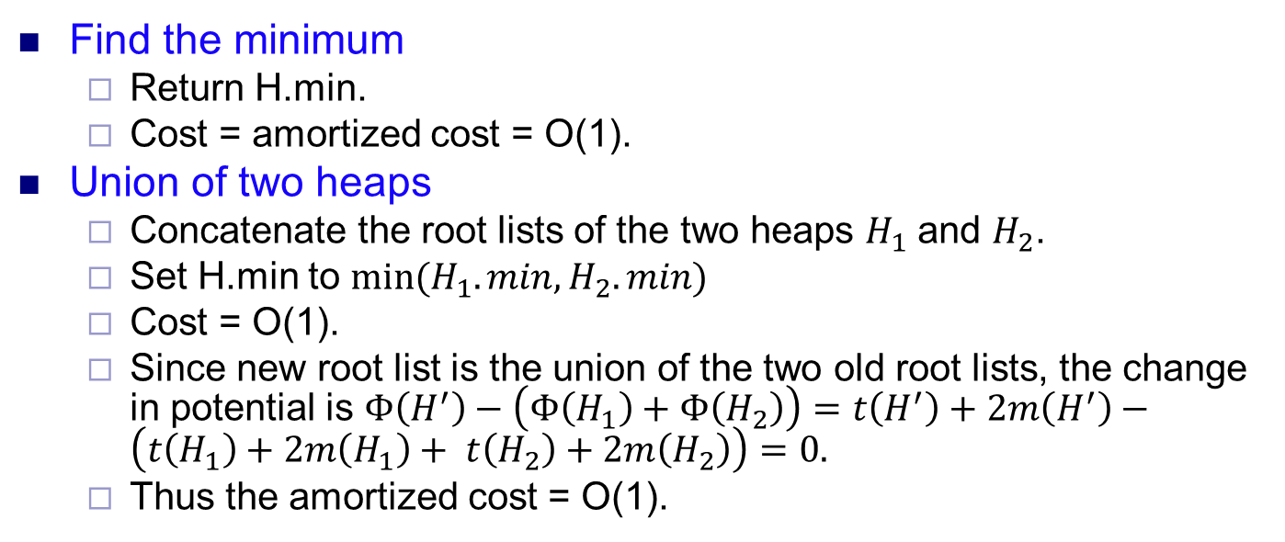
Basic operations
Find the minimum
Return H.min.
Cost = amortized cost = O(1).
Union of two heaps
Concatenate the root lists of the two heaps $H_{1}$ and $H_{2}$.
Set H.min to $min⁡(H_{1}.min, H_{2}.min)$
Cost = O(1).
Since new root list is the union of the two old root lists, the change in potential is $Φ\left(H^{′}\right)−\left(Φ\left(H_{1}\right)+Φ\left(H_{2}\right)\right)=t\left(H^{′}\right)+2m\left(H^{′}\right)−\left(t\left(H_{1}\right)+2m\left(H_{1}\right)+ t\left(H_{2}\right)+2m\left(H_{2}\right)\right)=0.$
Thus the amortized cost = O(1).

Slide 13
Extract min node
First remove the H.min node.
Then add each of its children (along with its subtree) to the root list.
There may now be many trees in the root list.
To find the new H.min, we need to iterate through the roots of all the trees, which may be slow.
So we want to decrease the number of trees in the root list.
Def The degree of a node is its number of children.
We merge some of the trees in the root list, so that none of the roots have the same degree.
The merging function is called CONSOLIDATE.

Slide 14
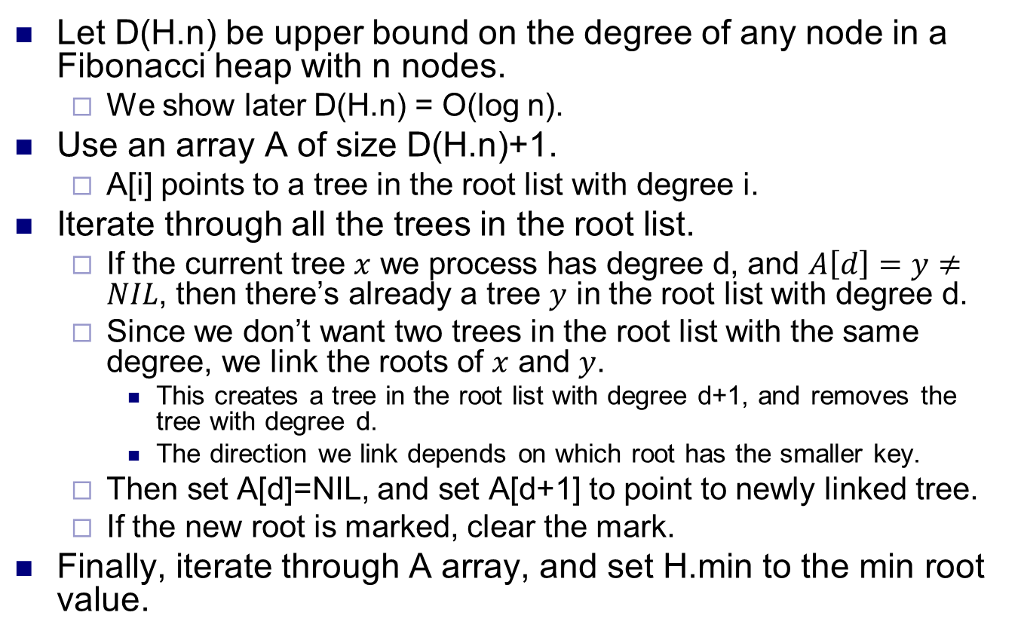
CONSOLIDATE
Let D(H.n) be upper bound on the degree of any node in a Fibonacci heap with n nodes.
We show later D(H.n) = O(log n).
Use an array A of size D(H.n)+1.
A[i] points to a tree in the root list with degree i.
Iterate through all the trees in the root list.
If the current tree $x$ we process has degree d, and $A\left[d\right]=y≠NIL$, then there’s already a tree $y$ in the root list with degree d.
Since we don’t want two trees in the root list with the same degree, we link the roots of $x$ and $y$.
This creates a tree in the root list with degree d+1, and removes the tree with degree d.
The direction we link depends on which root has the smaller key.
Then set A[d]=NIL, and set A[d+1] to point to newly linked tree.
If the new root is marked, clear the mark.
Finally, iterate through A array, and set H.min to the min root value.

Slide 15
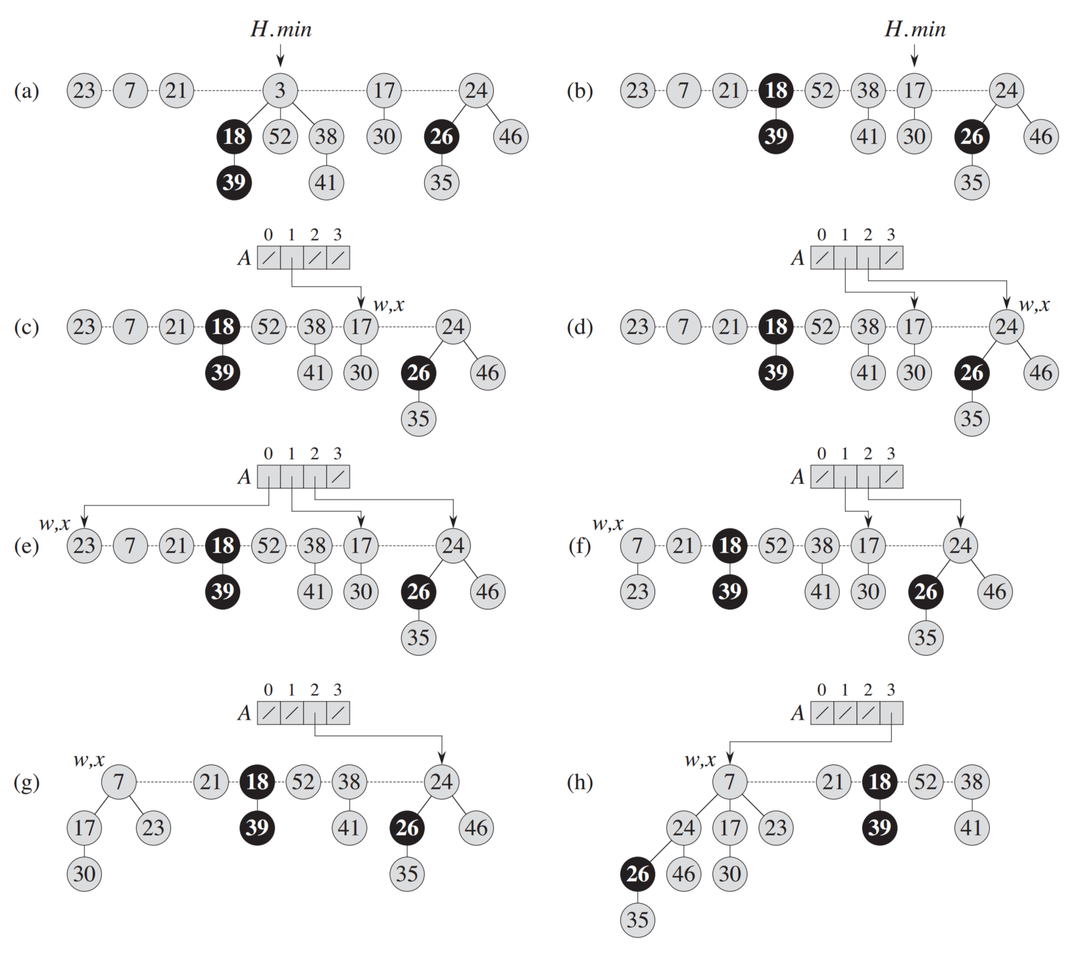
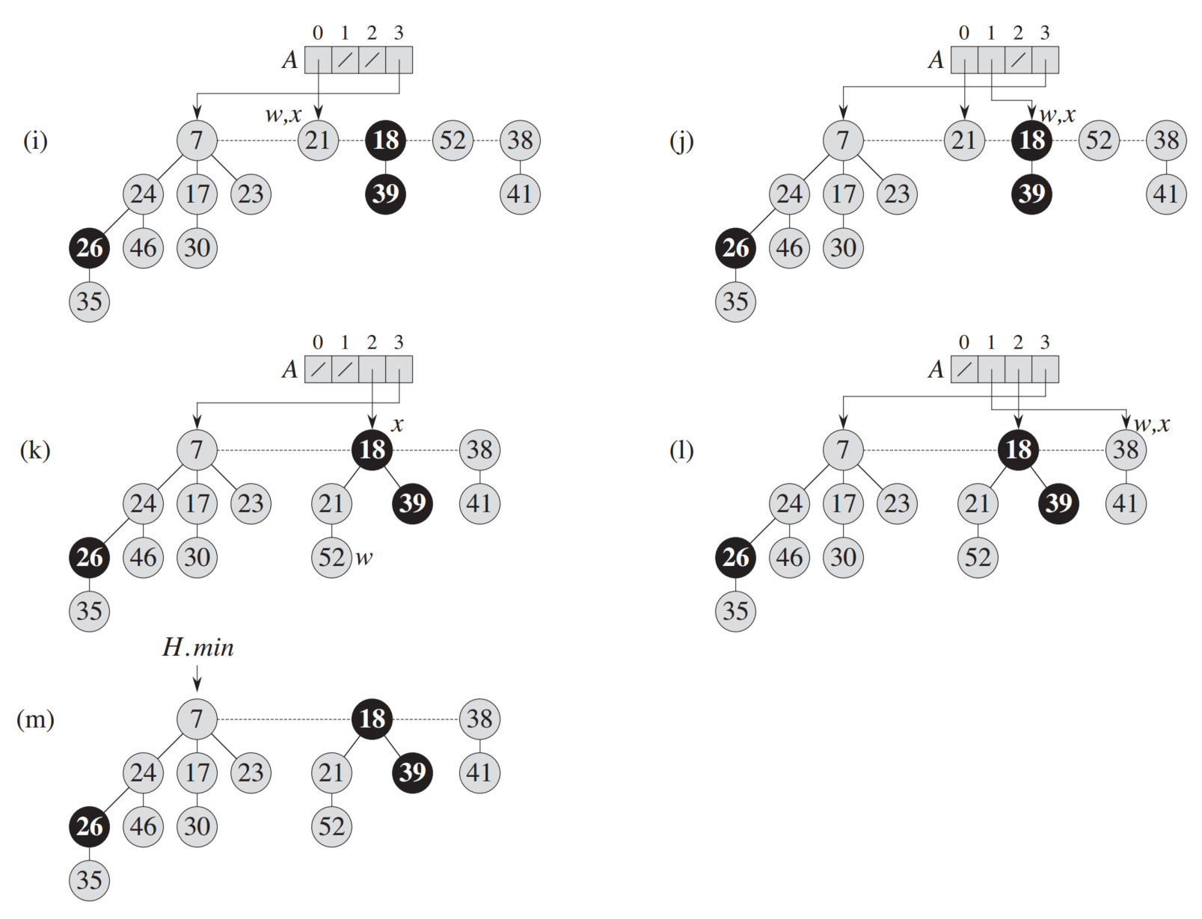
Example: Extract min

Slide 16
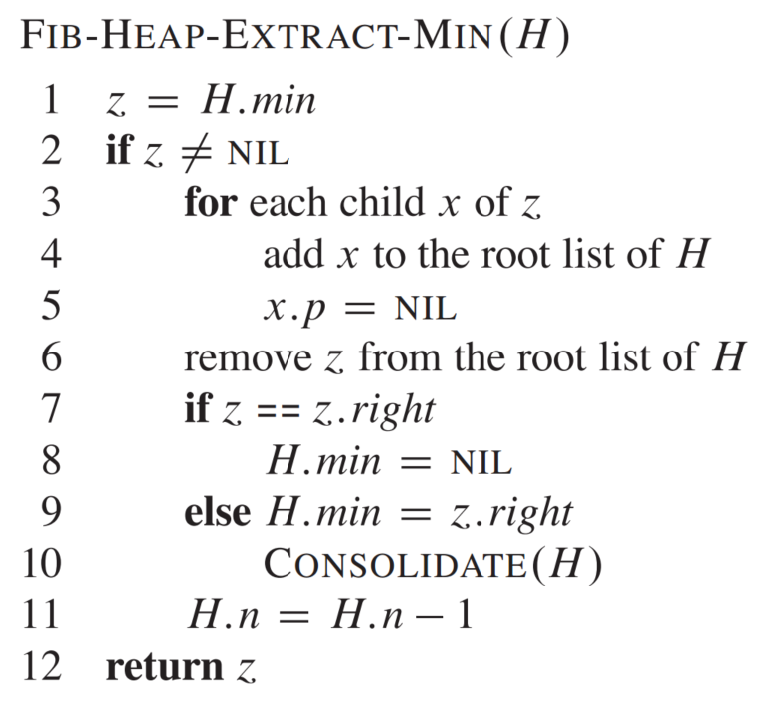
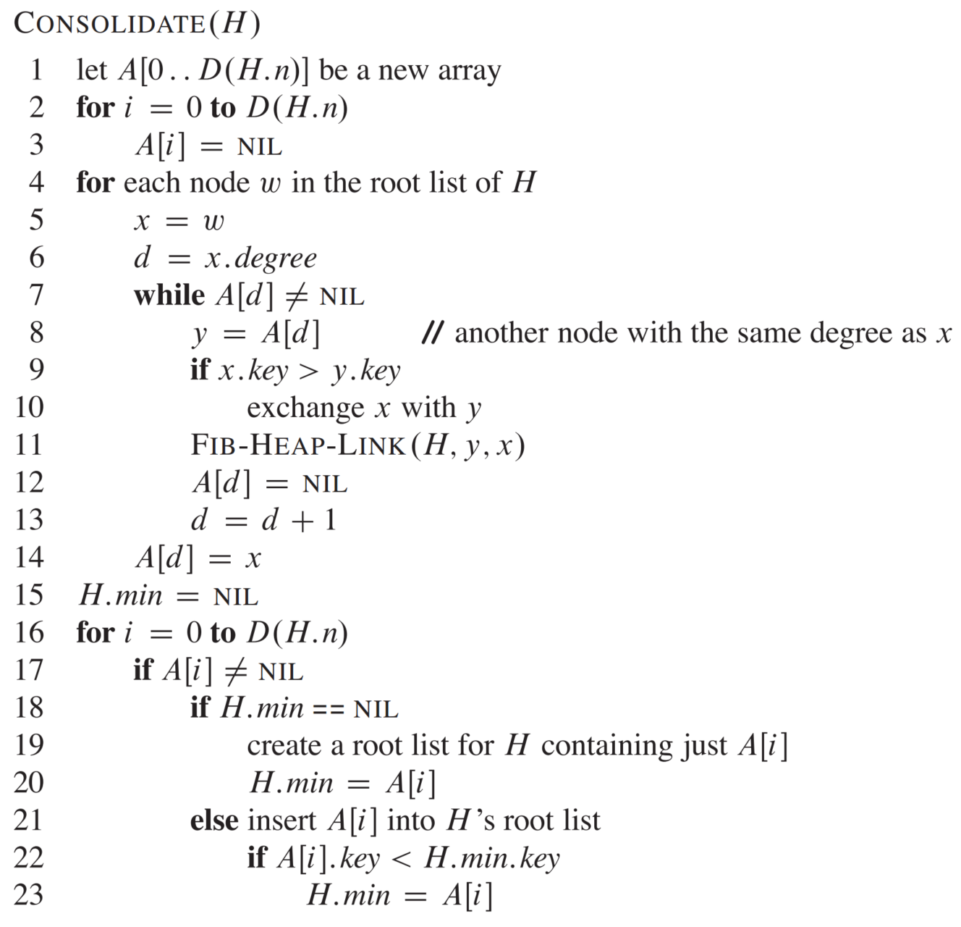
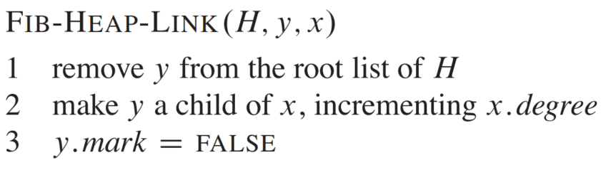
Pseudocode for extract min

Slide 17
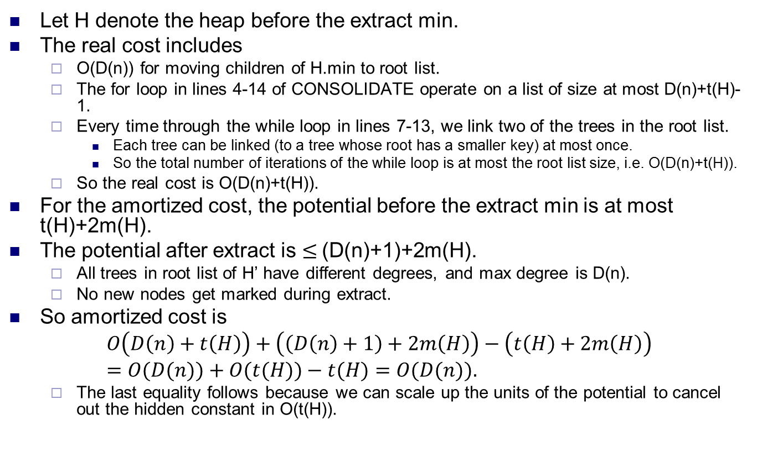
Complexity for extract min
Let H denote the heap before the extract min.
The real cost includes
O(D(n)) for moving children of H.min to root list.
The for loop in lines 4-14 of CONSOLIDATE operate on a list of size at most D(n)+t(H)-1.
Every time through the while loop in lines 7-13, we link two of the trees in the root list.
Each tree can be linked (to a tree whose root has a smaller key) at most once.
So the total number of iterations of the while loop is at most the root list size, i.e. O(D(n)+t(H)).
So the real cost is O(D(n)+t(H)).
For the amortized cost, the potential before the extract min is at most t(H)+2m(H).
The potential after extract is $≤$(D(n)+1)+2m(H).
All trees in root list of H’ have different degrees, and max degree is D(n).
No new nodes get marked during extract.
So amortized cost is
$$O\left(D\left(n\right)+t\left(H\right)\right)+\left(\left(D\left(n\right)+1\right)+2m\left(H\right)\right)−\left(t\left(H\right)+2m\left(H\right)\right)=O(D(n))+O(t(H))−t(H)=O(D(n)).$$
The last equality follows because we can scale up the units of the potential to cancel out the hidden constant in O(t(H)).

Slide 18
Decreasing key and marking
To decrease a node x’s key, check if the new key violates the heap property.
If not, we’re done.
Otherwise, move x and its subtree to the root list.
We say we cut out x (and its subtree).
Unmark x, if it’s marked.
A node is marked if one of its children has been cut, since the last time it’s been cut.
The second time a node’s children is cut out, we move the node (and its subtree) to the root list and unmark it.
Let y be x’s parent.
If y is not marked, mark y, since we cut one of its children.
If y is already marked, move y and its subtree to the root list, and then unmark y.
Let z be y’s parent.
If z is not marked, stop. Otherwise, cut z and move it to the root list, and repeat the previous steps for z’s parent, etc.
One decrease key can create a sequence of cascading cuts.

Slide 19
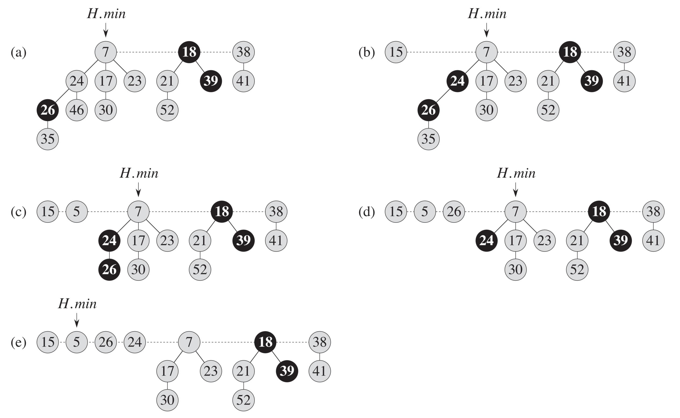
Example: decrease key
(a) shows the original Fibonacci heap.
(b) shows the heap after node 46 is decreased to 15.
(c)-(e) show the cascading cuts after node 35 is decreased to 5.

Slide 20
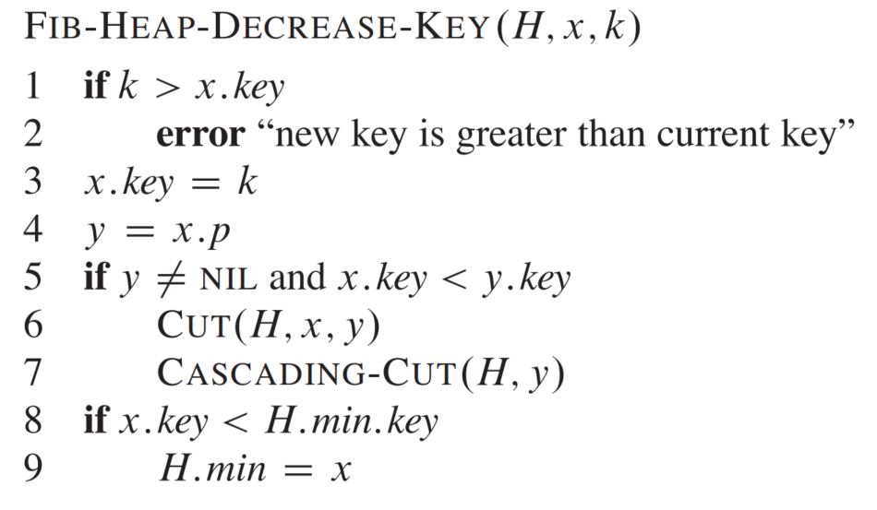
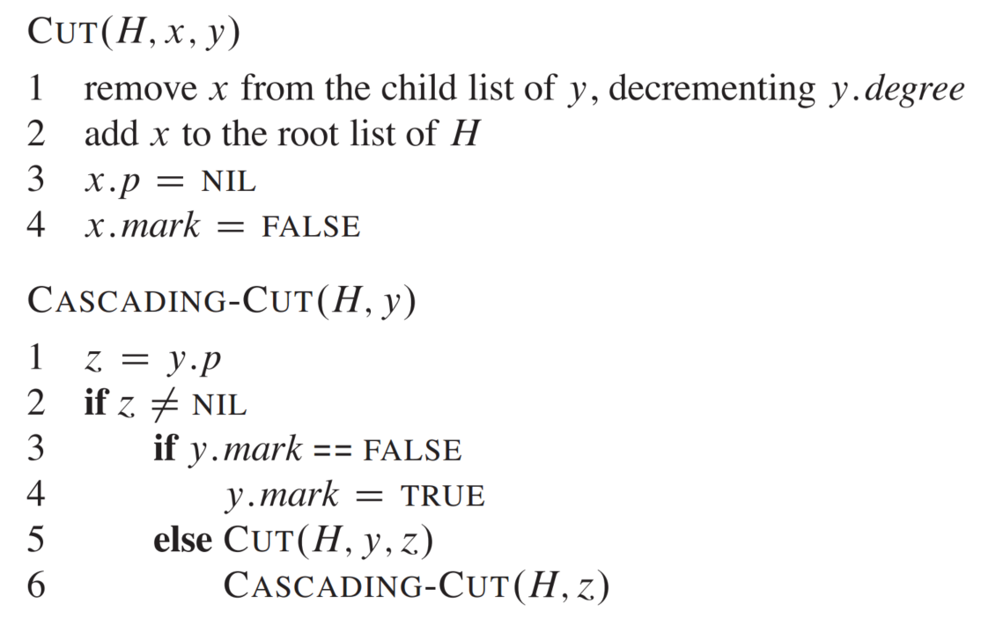
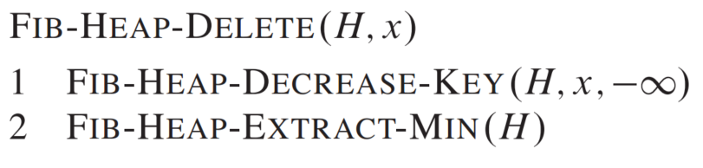

Pseudocode for decrease key and delete
To delete a key, simply decrease its value to $−∞$ and then do a extract-min.

Slide 21
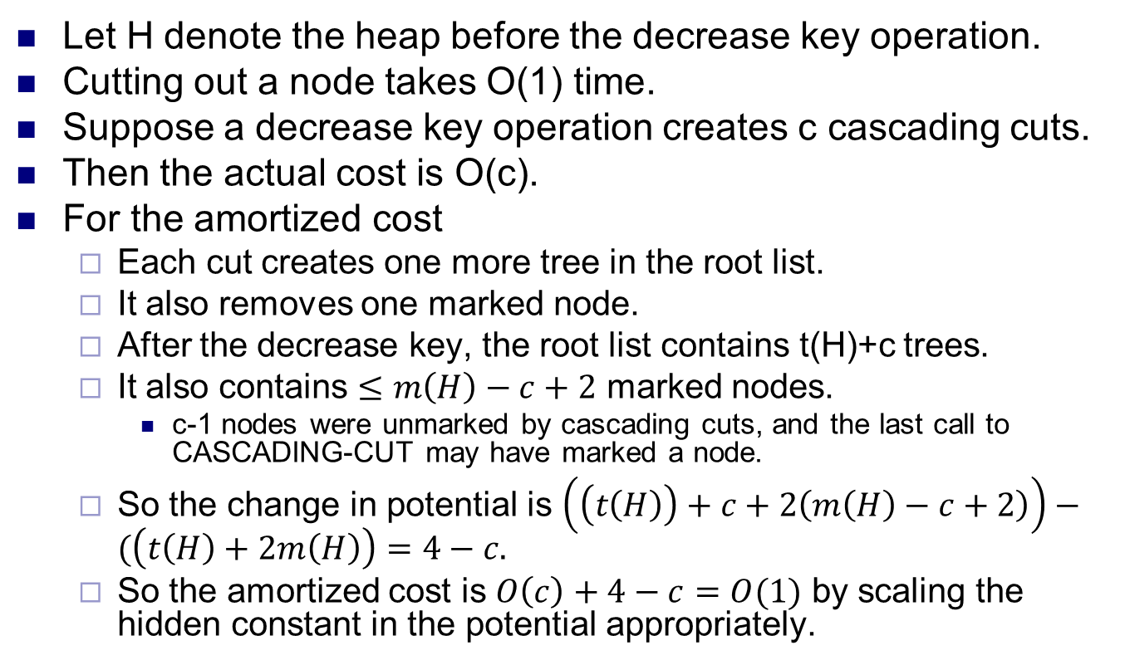
Complexity for decrease key
Let H denote the heap before the decrease key operation.
Cutting out a node takes O(1) time.
Suppose a decrease key operation creates c cascading cuts.
Then the actual cost is O(c).
For the amortized cost
Each cut creates one more tree in the root list.
It also removes one marked node.
After the decrease key, the root list contains t(H)+c trees.
It also contains $≤m\left(H\right)−c+2$ marked nodes.
c-1 nodes were unmarked by cascading cuts, and the last call to CASCADING-CUT may have marked a node.
So the change in potential is $\left(\left(t\left(H\right)\right)+c+2\left(m\left(H\right)−c+2\right)\right)−(\left(t\left(H\right)+2m\left(H\right)\right)=4−c.$
So the amortized cost is $O\left(c\right)+4−c=O(1)$ by scaling the hidden constant in the potential appropriately.

Slide 22
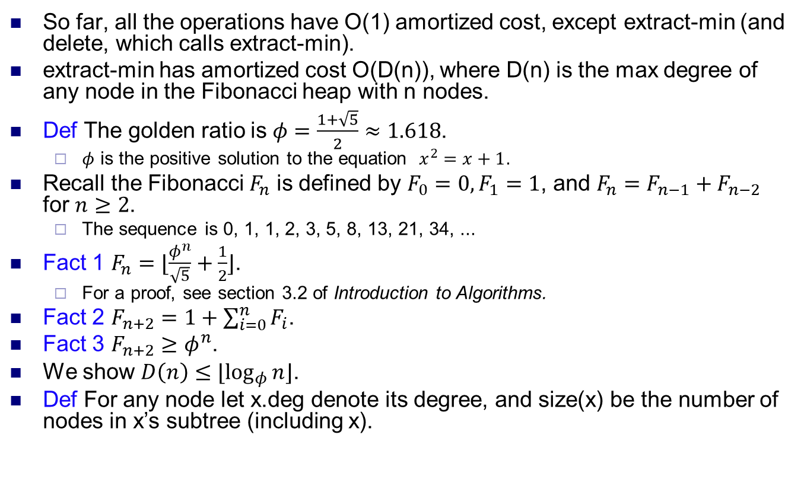
Bounding the max degree
So far, all the operations have O(1) amortized cost, except extract-min (and delete, which calls extract-min).
extract-min has amortized cost O(D(n)), where D(n) is the max degree of any node in the Fibonacci heap with n nodes.
Def The golden ratio is $φ=\frac{1+\sqrt{5}}{2}≈1.618$.
$φ$ is the positive solution to the equation $x^{2}=x+1$.
Recall the Fibonacci $F_{n}$ is defined by $F_{0}=0, F_{1}=1$, and $F_{n}=F_{n−1}+F_{n−2}$ for $n≥2$.
The sequence is 0, 1, 1, 2, 3, 5, 8, 13, 21, 34, ...
Fact 1 $F_{n}=⌊\frac{φ^{n}}{\sqrt{5}}+\frac{1}{2}⌋$.
For a proof, see section 3.2 of Introduction to Algorithms.
Fact 2 $F_{n+2}=1+\sum_{i=0}^{n}{F_{i}}$.
Fact 3 $F_{n+2}≥φ^{n}$.
We show $D\left(n\right)≤⌊\log_{φ}{n}⌋$.
Def For any node let x.deg denote its degree, and size(x) be the number of nodes in x’s subtree (including x).

Slide 23
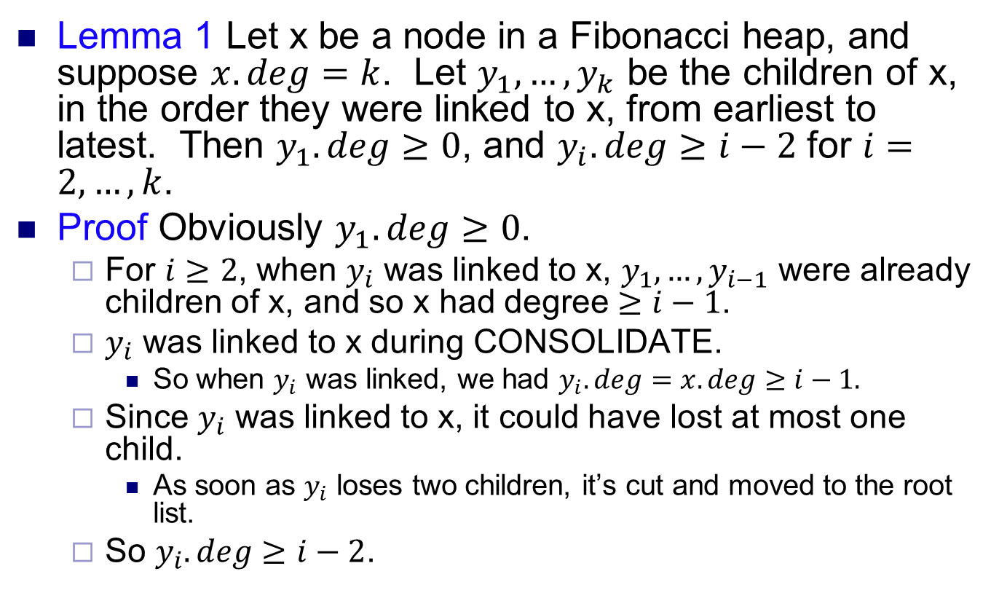
Bounding the max degree
Lemma 1 Let x be a node in a Fibonacci heap, and suppose $x.deg=k$. Let $y_{1},…, y_{k}$ be the children of x, in the order they were linked to x, from earliest to latest. Then $y_{1}.deg≥0$, and $y_{i}.deg≥i−2$ for $i=2, …, k$.
Proof Obviously $y_{1}.deg≥0$.
For $i≥2$, when $y_{i}$ was linked to x, $y_{1},…,y_{i−1}$ were already children of x, and so x had degree $≥i−1$.
$y_{i}$ was linked to x during CONSOLIDATE.
So when $y_{i}$ was linked, we had $y_{i}.deg=x.deg≥i−1.$
Since $y_{i}$ was linked to x, it could have lost at most one child.
As soon as $y_{i}$ loses two children, it’s cut and moved to the root list.
So $y_{i}.deg≥i−2$.

Slide 24
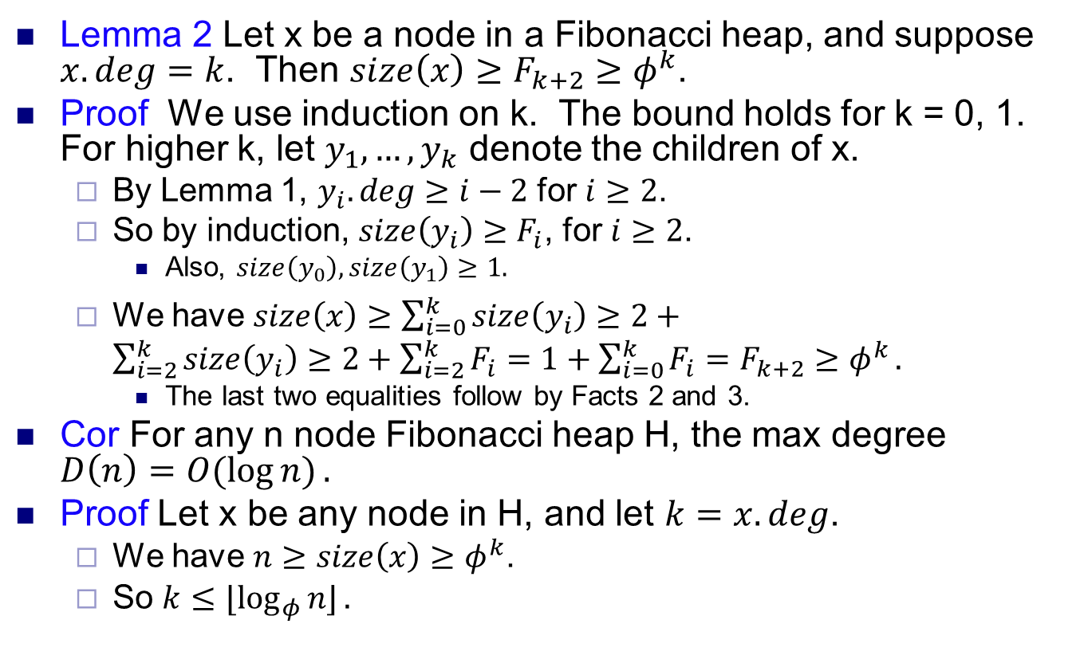
Bounding the max degree
Lemma 2 Let x be a node in a Fibonacci heap, and suppose $x.deg=k$. Then $size\left(x\right)≥F_{k+2}≥φ^{k}$.
Proof We use induction on k. The bound holds for k = 0, 1. For higher k, let $y_{1}, …, y_{k}$ denote the children of x.
By Lemma 1, $y_{i}.deg≥i−2$ for $i≥2$.
So by induction, $size\left(y_{i}\right)≥F_{i}$, for $i≥2$.
Also, $size\left(y_{0}\right), size\left(y_{1}\right)≥1.$
We have $size\left(x\right)≥\sum_{i=0}^{k}{size\left(y_{i}\right)}≥2+\sum_{i=2}^{k}{size\left(y_{i}\right)≥2+\sum_{i=2}^{k}{F_{i}=1+\sum_{i=0}^{k}{F_{i}=F_{k+2}}≥φ^{k}}.}$
The last two equalities follow by Facts 2 and 3.
Cor For any n node Fibonacci heap H, the max degree $D\left(n\right)=O(\log{n)}.$
Proof Let x be any node in H, and let $k=x.deg$.
We have $n≥size\left(x\right)≥φ^{k}$.
So $k≤⌊\log_{φ}{n⌋}.$

